Slide 1
Index Notation: Index Law 1 and Index Law 2
Year 8 Mathematics
Mrs Parlevliet

Slide 2
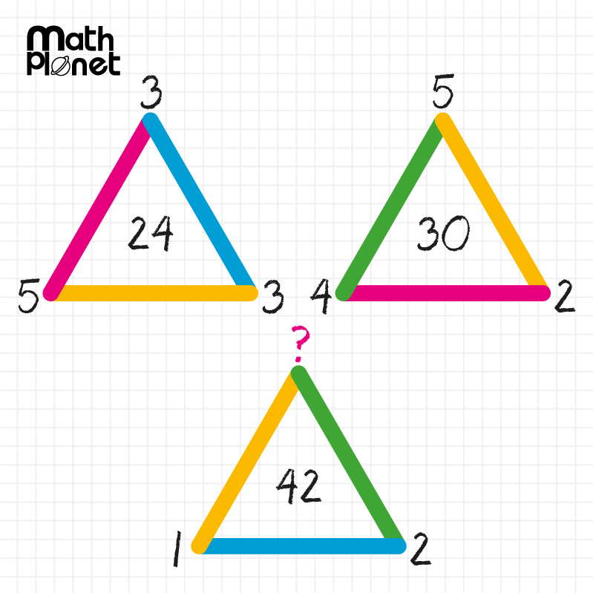
24
7
30
Index Notation
Date
EQ – What is Index Law 1 and Index Law 2?
Notes:
If students don’t know where to begin, give them a clue that they need to use Order of Operations to link the numbers on the vertices to the number inside the triangle.

Slide 3
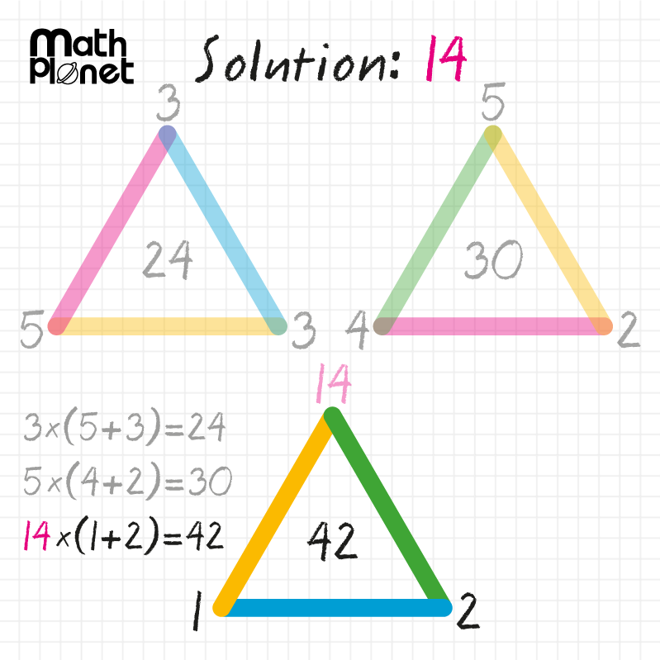
24
7
30
Index Notation
Date
EQ – What is Index Law 1 and Index Law 2?

Slide 4
24
7
30
Index Notation
Date
EQ – How do I use Index Law 1 and Index Law 2?
How do I use Index Law 1?
Index Law 1
When multiplying numbers written using powers, if the base number is the same, add the indices.
a^{m} x a^{n} = a^{m+n}
Example 1: Write 7⁵ x 7³ as a single power of seven
7⁵ x 7³ means (7 x 7 x 7 x 7 x 7) x (7 x 7 x 7)
There are 5 + 3 = 8 factors of 7 in the product, so the product is 7⁸.
We add the two indices to get the answer: 7⁵×7³=7⁸
Notes:
You may need to explain that the variables, a, m, and n represent integer values, particularly if you are teaching a general class of students with mixed abilities.
Terms in red indicate that they should be added to the glossary or formula page.

Slide 5
You Do (Left Hand Side)
Question 1: Write 5² x 5³ as a single power of 5
5² x 5³
= 5²⁺³
= 5⁵
Question 2: Write b³ x b⁴ as a single power of 5
b³ x b⁴
= (b x b x b) x (b x b x b x b)
= b³⁺⁴
= b⁷

Slide 6
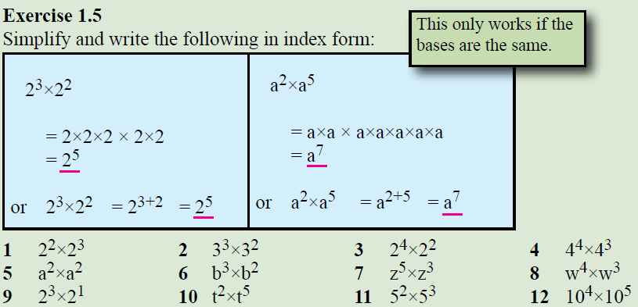
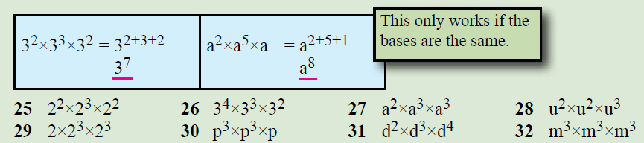
Task: Dwyer 8 Text
Index Law 1
a^{m} x a^{n} = a^{m+n}

Slide 7

24
7
30
Index Notation
Date
EQ – How do I use Index Law 1 and Index Law 2?
How do I use Index Law 2?
Index Law 2
When multiplying numbers written using powers, if the base number is the same, add the indices.
a^{m} $÷$ a^{n} = a^{m-n}
Notes:
You may need to explain that the variables, a, m, and n represent integer values, particularly if you are teaching a general class of students with mixed abilities.
Terms in red indicate that they should be added to the glossary or formula page.

Slide 8
24
7
30
Index Notation
Date
EQ – What is Index Law 1 and Index Law 2?
Example 4: Simplify 6⁷ ÷ 6⁴
How do I use Index Law 2?
6⁷ ÷ 6⁴ = (6 x 6 x 6 x 6 x 6 x 6 x 6)
(6 x 6 x 6 x 6)
6⁷ ÷ 6⁴ = (6 x 6 x 6 x 6 x 6 x 6 x 6) (Four factors cancel out)
(6 x 6 x 6 x 6)
= (6 x 6 x 6) (This leaves 7 – 4 = 3 factors left)
= 6⁷⁻⁴
= 6³
Example 5: Write 5⁶ ÷ 5⁴ as a single power of 5
5⁶ ÷ 5⁴ = 5⁶⁻⁴
= 5²

Slide 9
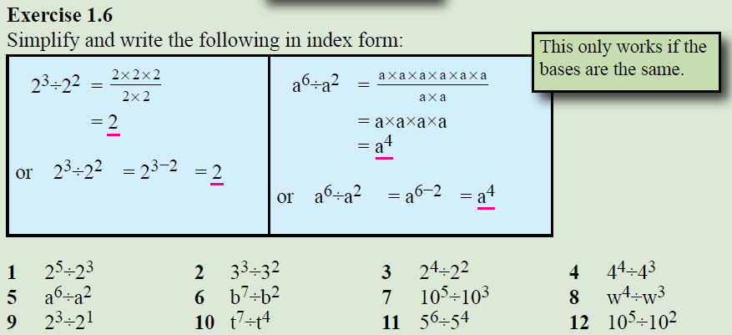
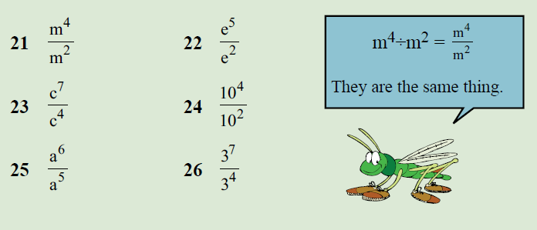

Task: Dwyer 8 Text
Index Law 2
a^{m} $÷$ a^{n} = a^{m-n}

